Slide 1
Simulation of Mammalian Sperm in Viscous Media
Sunil Klein
Yuan-Hung Lo

Slide 2
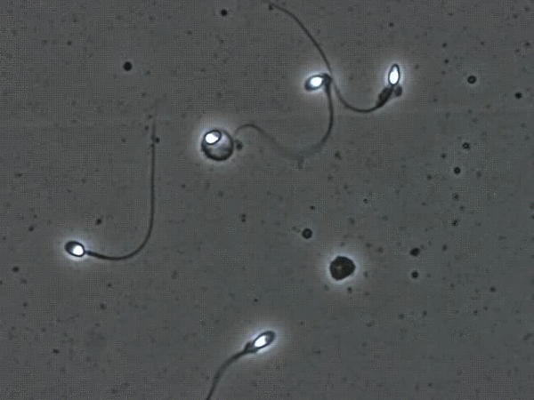
Overview of project
Goal:
MATLAB simulation of an actuated sperm in a viscous fluid
Simulate buckling behavior and analyze the characteristics of progressive motility
Methods:
Based on a discrete elastic beam
2D simulation to capture lateral, whip-like flagellum motion
Assumptions:
Low Reynolds number
Newtonian fluid
Movement of Sperm
Notes:
Low Reynolds Number: for microorganisms like sperm, inertial effects are negligible compared to viscous effects; behaves more like a Newtonian fluid; easier to model

Slide 3
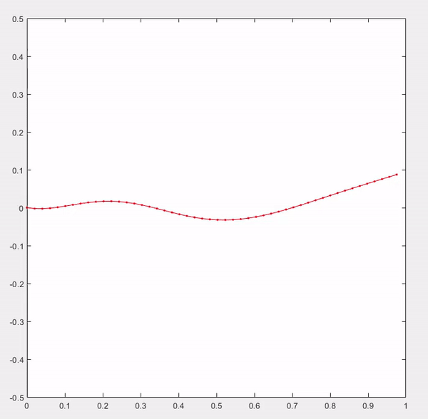
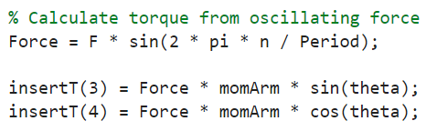
Progress Made
Used similar environment as discrete elastic beam model and change orientation
Introduced oscillating external torque and calculate force components to create rudimentary actuation
Evaluate oscillation and found natural frequencies, achieving efficient movement

Slide 4
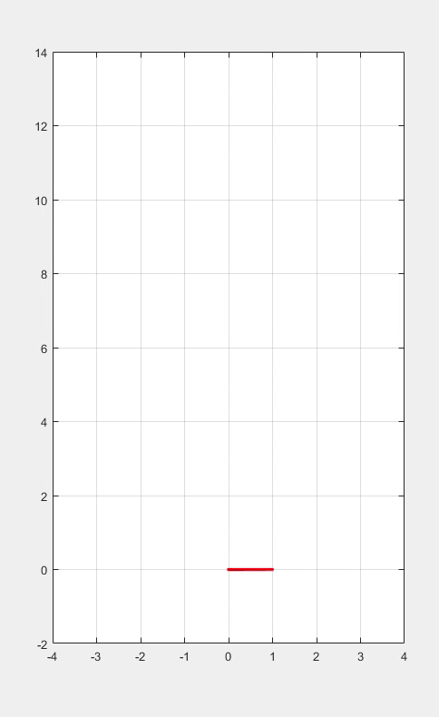
Progress Made
Used similar environment as discrete elastic beam model and change orientation
Introduced oscillating external torque and calculate force components to create rudimentary actuation
Evaluate oscillation and found natural frequencies, achieving efficient movement

Slide 5
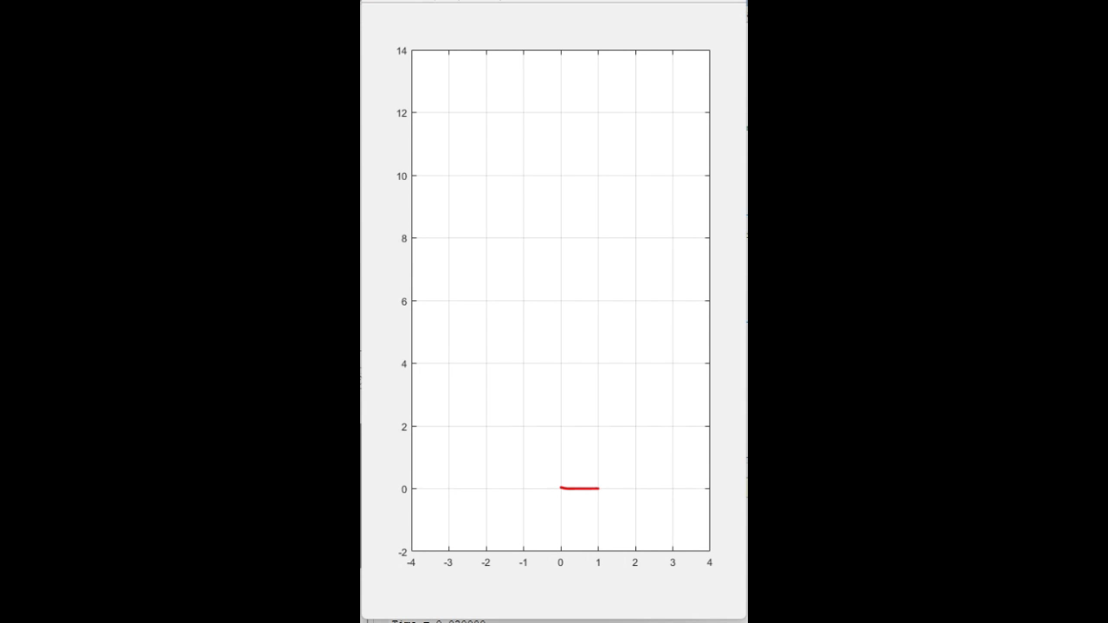
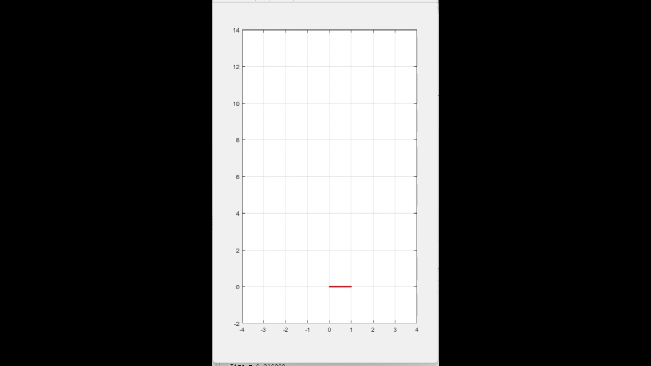
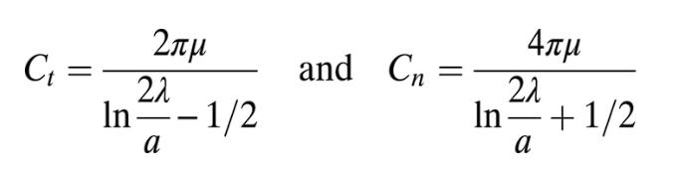
Simulating motility
Create sequence of movement with different force and oscillation frequency input
Recreate buckling in flagellum with sudden input change
Introduced Gray and Hancock’s drag coefficient to accurately simulate dynamic characteristics
Gray and Hancock’s drag coefficients [9]
Without Drag Force
With Drag Force

Slide 6
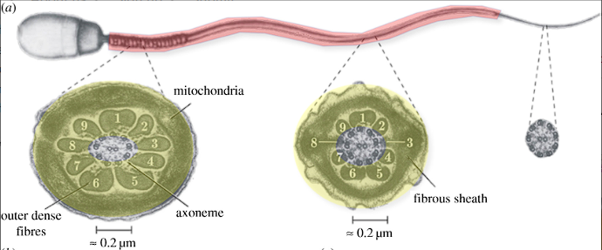
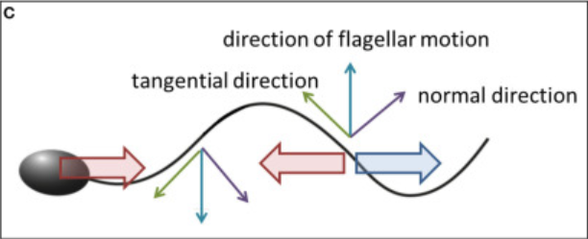
Next Steps
Define head geometry and mass
Incorporate variable rigidity (i.e., more rigid closer to the head, more flexible closer to the flagellum)
Replace external force with internal actuation based on Slender-body theory
Implement deformation to mimic a beating flagellum with changing curvature
Instead of using an external force, the sperm will exert force on the surrounding fluid to actuate (RFT)
Cross-sections at different locations along flagellum’s length [5]
Resistive Force Theory, Gray and Hancock (1955)
Notes:
RFT = Twice as much force per unit length is required to move the flagellum through the fluid perpendicular to itself compared to tangentially

Slide 7
Questions

Slide 8
References
[1] Cass, James F., and Hermes Bloomfield-Gadêlha. “The Reaction-Diffusion Basis of Animated Patterns in Eukaryotic Flagella.” Nature News, Nature Publishing Group, 27 Sept. 2023, www.nature.com/articles/s41467-023-40338-2.
[2] Corkidi, G., et al. “Long-Term Segmentation-Free Assessment of Head-Flagellum Movement and Intracellular Calcium in Swimming Human Sperm.” University of Bristol, Company of Biologists Ltd, 11 Feb. 2022, research-information.bris.ac.uk/en/publications/long-term-segmentation-free-assessment-of-head-flagellum-movement.
[3] Forghani, Mojtaba, et al. “Control of Uniflagellar Soft Robots at Low Reynolds Number Using Buckling Instability.” ASME Digital Collection, American Society of Mechanical Engineers Digital Collection, 1 Feb. 2021, asmedigitalcollection.asme.org/dynamicsystems/article/143/6/061004/1094088/Control-of-Uniflagellar-Soft-Robots-at-Low.
[4] Gadelha, H, et al. Nonlinear Instability in Flagellar Dynamics: A Novel Modulation Mechanism in Sperm Migration?, Royal Society Publishing, 12 May 2010, royalsocietypublishing.org/doi/10.1098/rsif.2010.0136.
[5] Gadelha, Hermes, and Eamonn Gaffney. Flagellar Ultrastructure Suppresses Buckling Instabilities and Enables Mammalian Sperm Navigation in High-Viscosity Media, Royal Society Publishing, 20 Mar. 2019, royalsocietypublishing.org/doi/10.1098/rsif.2018.0668.
[6] Huang, Weicheng, and M. K. Jawed. “Numerical Exploration on Buckling Instability for Directional Control in Flagellar Propulsion.” Soft Matter, The Royal Society of Chemistry, 10 Dec. 2019, pubs.rsc.org/en/content/articlelanding/2020/SM/C9SM01843C.
[7] Leung, Miguel Ricardo, et al. The Multi-Scale Architecture of Mammalian Sperm Flagella and Implications for Ciliary Motility, Embo Press, 10 Mar. 2021, www.embopress.org/doi/full/10.15252/embj.2020107410.
[8] Moreau, Clement, et al. The Asymptotic Coarse-Graining Formulation of Slender-Rods, Bio-Filaments and Flagella, Royal Society Publishing, 4 July 2018, royalsocietypublishing.org/doi/10.1098/rsif.2018.0235.
[9] Rodenborn, Bruce, et al. “Propulsion of Microorganisms by a Helical Flagellum | PNAS.” Propulsion of Microorganisms by a Helical Flagellum, PNAS, 28 Nov. 2012, www.pnas.org/doi/10.1073/pnas.1219831110.
[10] Simons, Julie E., and Sarah D. Olson. “Sperm Motility: Models for Dynamic Behavior in Complex Environments.” SpringerLink, Springer International Publishing, 1 Jan. 1970, link.springer.com/chapter/10.1007/978-3-319-96842-1_7.
[11] Smith, D.J., et al. Bend Propagation in the Flagella of Migrating Human Sperm, and Its Modulation by Viscosity, Wiley Online Library, 25 Feb. 2009, onlinelibrary.wiley.com/doi/abs/10.1002/cm.20345.

Slide 9
Image Sources
Slide 2:
Measurement uncertainty and sperm morphology (andrologyconsulting.com)
Slide 6:
https://www.ncbi.nlm.nih.gov/pmc/articles/PMC8329702/

